Slide 1
CSC3050 – Computer Architecture Arithematic and Logic Unit
Prof. Yeh-Ching Chung
School of Science and Engineering
Chinese University of Hong Kong, Shenzhen

Slide 2
Arithmetic for Computers
Operations on integers
Addition and subtraction
Multiplication and division
Dealing with overflow
Floating-point real numbers
Representation and operations

Slide 3
MIPS Arithmetic and Logic Unit (ALU)
Must support the Arithmetic/Logic operations of the ISA
add, addi, addiu, addu
sub, subu
mult, multu, div, divu
sqrt
and, andi, nor, or, ori, xor, xori
beq, bne, slt, slti, sltiu, sltu
With special handling for
sign extend – addi, addiu, slti, sltiu
zero extend – andi, ori, xori
overflow detection – add, addi, sub
zero
overflow
32
A
ALU
32
result
32
B
4
m (operation)

Slide 4
MIPS Arithmetic and Logic Instructions
R format
op
rs
rt
rd
shamt
funct
I format
op
rs
rt
immediate
R-format
I-format
 | op | funct
add | 000000 | 100000
addu | 000000 | 100001
sub | 000000 | 100010
subu | 000000 | 100011
and | 000000 | 100100
or | 000000 | 100101
xor | 000000 | 100110
nor | 000000 | 100111
 | op | funct
slt | 000000 | 101010
sltu | 000000 | 101011
 | op
addi | 001000
addiu | 001001
slti | 001010
sltiu | 001011
andi | 001100
ori | 001101
xori | 001110
lui | 001111

Slide 5
Design MIPS ALU
Requirements: must support the following arithmetic and logic operations
add, sub: Two’s complement adder/subtractor with overflow detection
and, or, nor : Logical AND, logical OR, logical NOR
slt (set on less than): Two’s complement adder with inverter, check sign bit of result

Slide 6
Design Approach
Design trick 1: Divide and conquer
Break the problem into simpler problems, solve them and glue together the solution
Design trick 2: Solve part of the problem and extend
Design trick 3: Take pieces you know (or can imagine) and try to put them together

Slide 7
Function Specification
ALUop
4
ALU Control (ALUop) Function
0000 and
0001 or
0010 add
0110 subtract
0111 set-on-less-than
1100 nor
A
32
Zero
ALU
Result
32
Overflow
B
32
CarryOut
Notes:
Now you remember what binary numbers are, let design an Arithmetic Logic Unit that can perform bitwise AND, bitwise OR, binary add, binary subtract, and et-on-less-than.
The type of operation the ALU perform will be selected by the ALUop bits.
The ALU I am going to show you in class is 4 bits wide (N = 4). The ALU you need to design for the next homework assignment will be 32 bits wide.
I will show you how to implement all these operations except the last one, which is left as your homework assignment.
+1 = 25 min. (Y:05)

Slide 8
The Diagram of a 32-Bit ALU
A
32
B
32
ALUop
4
A
a0
b0
32
a31
b31
4
Zero
m
ALU₀
m
ALU₃₁
ALU
Result
co
cin
ALUop
32
c31
cin
s0
Overflow
s31
B
32
CarryOut
Overflow
Zero
32
Result

Slide 9
Function Specification
ALUop
4
ALU Control (ALUop) Function k
0000 and
0001 or
0010 add
0110 subtract
0111 set-on-less-than
1100 nor
A
32
Zero
ALU
Result
32
Overflow
B
32
CarryOut
Notes:
Now that I have shown you how to build a 1-bit full adder, we have all the major components needed for this 1-bit ALU.
In order to build a 4-bit ALU, we simply connect four 1-bit ALUs in series to feed the CarryOut of one ALU to the CarryIn of the next ALU.
Even though I called this an ALU, I actually lied a little. There is something missing about this ALU. This ALU can NOT perform the subtract operation.
Let see how can we fix this problem.
2 min = 35 min. (Y:15)

Slide 10
A 1-bit ALU – And, Or, and Add Operations
CarryIn
Operation
and
A
0
or
Result
1
Mux
1-bit
Full
Adder
add
2
B
CarryOut
Notes:
Now that I have shown you how to build a 1-bit full adder, we have all the major components needed for this 1-bit ALU.
In order to build a 4-bit ALU, we simply connect four 1-bit ALUs in series to feed the CarryOut of one ALU to the CarryIn of the next ALU.
Even though I called this an ALU, I actually lied a little. There is something missing about this ALU. This ALU can NOT perform the subtract operation.
Let see how can we fix this problem.
2 min = 35 min. (Y:15)

Slide 11
A 4-bit ALU – And, Or, and Add Operations
1-bit ALU
4-bit ALU
CarryIn
CarryIn0
Operation
Operation
A0
1-bit
ALU
A
Result0
B0
CarryIn1
CarryOut0
A1
1-bit
ALU
Result1
Result
B1
Mux
CarryOut1
CarryIn2
A2
1-bit
ALU
Result2
B2
1-bit
Full
Adder
CarryOut2
CarryIn3
B
A3
1-bit
ALU
Result3
B3
CarryOut
CarryOut3
Notes:
Now that I have shown you how to build a 1-bit full adder, we have all the major components needed for this 1-bit ALU.
In order to build a 4-bit ALU, we simply connect four 1-bit ALUs in series to feed the CarryOut of one ALU to the CarryIn of the next ALU.
Even though I called this an ALU, I actually lied a little. There is something missing about this ALU. This ALU can NOT perform the subtract operation.
Let see how can we fix this problem.
2 min = 35 min. (Y:15)

Slide 12
Function Specification
ALUop
ALU Control (ALUop) Function
0000 and
0001 or
0010 add
0110 subtract
0111 set-on-less-than
1100 nor
4
A
32
Zero
ALU
Result
32
Overflow
B
32
CarryOut
Notes:
Now you remember what binary numbers are, let design an Arithmetic Logic Unit that can perform bitwise AND, bitwise OR, binary add, binary subtract, and et-on-less-than.
The type of operation the ALU perform will be selected by the ALUop bits.
The ALU I am going to show you in class is 4 bits wide (N = 4). The ALU you need to design for the next homework assignment will be 32 bits wide.
I will show you how to implement all these operations except the last one, which is left as your homework assignment.
+1 = 25 min. (Y:05)

Slide 13
Subtraction Operation
2’s complement: Take inverse of every bit and add 1 (at c_{in} of first stage)
A + B’ + 1 = A + (B’ + 1) = A + (-B) = A - B
Bit-wise inverse of B is B’
Subtract
(Bnegate)
CarryIn
Operation
A
ALU
Result
Sel
B
0
Mux
1
B’
CarryOut
Notes:
Recalled something you learned from grade school that: A - B is the same as A plus (-B).
Also recall from earlier slides that in order to calculate the 2 complement representation of negative B, we simply take the inverse of very bit and add 1.
The bitwise inverse of B is easy to compute. Just pass them through the inverter.
In order to do the add 1 operation, we simply set the CarryIn to 1.
So for the subtract operation, we simply select the output of the inverter and set CarryIn to 1.
Then we will be adding A to the negative of B and whola, we have the A minus B operation.
+2 = 37 min. (Y:17)

Slide 14
Revised Diagram
LSB and MSB need to do a little extra
A
32
B
32
a31
b31
a0
b0
4
ALU31
ALU0
?
co
cin
ALUop
c31
cin
s0
s31
Supply a 1 on subtraction
32
Overflow
Zero
Combining the CarryIn and Bnegate
Result

Slide 15
Function Specification
ALUop
4
ALU Control (ALUop) Function
0000 and
0001 or
0010 add
0110 subtract
0111 set-on-less-than
1100 nor
A
32
Zero
ALU
Result
32
Overflow
B
32
CarryOut
Notes:
Now you remember what binary numbers are, let design an Arithmetic Logic Unit that can perform bitwise AND, bitwise OR, binary add, binary subtract, and et-on-less-than.
The type of operation the ALU perform will be selected by the ALUop bits.
The ALU I am going to show you in class is 4 bits wide (N = 4). The ALU you need to design for the next homework assignment will be 32 bits wide.
I will show you how to implement all these operations except the last one, which is left as your homework assignment.
+1 = 25 min. (Y:05)

Slide 16
Nor Operation
A nor B = (not A) and (not B)
ALUop
2
Ainvert
CarryIn
Operation
a
0
0
1
Bnegate
1
Result
b
0
2
1
CarryOut

Slide 17
Function Specification
ALUop
ALU Control (ALUop) Function
0000 and
0001 or
0010 add
0110 subtract
0111 set-on-less-than
1100 nor
4
A
32
Zero
ALU
Result
32
Overflow
B
32
CarryOut
Notes:
Now you remember what binary numbers are, let design an Arithmetic Logic Unit that can perform bitwise AND, bitwise OR, binary add, binary subtract, and et-on-less-than.
The type of operation the ALU perform will be selected by the ALUop bits.
The ALU I am going to show you in class is 4 bits wide (N = 4). The ALU you need to design for the next homework assignment will be 32 bits wide.
I will show you how to implement all these operations except the last one, which is left as your homework assignment.
+1 = 25 min. (Y:05)

Slide 18
Set on Less Than (1)
slt rd, rs, rt (if (rs < rt) rd = 1; else rd = 0;)
1-bit in ALU (for bits 1-30)
ALUop
Ainvert
CarryIn
Operation
a
0
0
1
Bnegate
1
Result
b
0
2
1
Less
(0:bits 1-30)
3
CarryOut

Slide 19
Set on Less Than (2)
Sign bit in ALU (bit 31)
Ainvert
CarryIn
Operation
a
0
0
1
Bnegate
1
Result
b
0
2
1
Less
3
Set
Overflow
detection
Overflow

Slide 20
Set on Less Than (3)
Bit 0 in ALU
ALUop
Ainvert
CarryIn
Operation
a
0
0
1
Bnegate
1
Result
b
0
2
1
Set
3
CarryOut

Slide 21
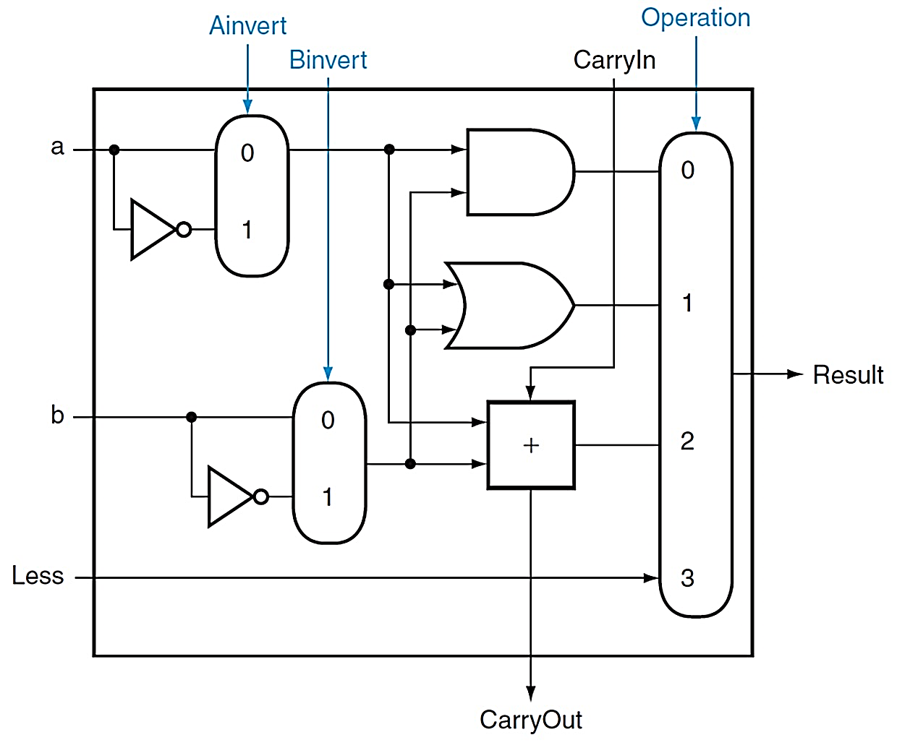
(Simplified) 1-bit MIPS ALU
and, or, nor, add, sub, slt

Slide 22
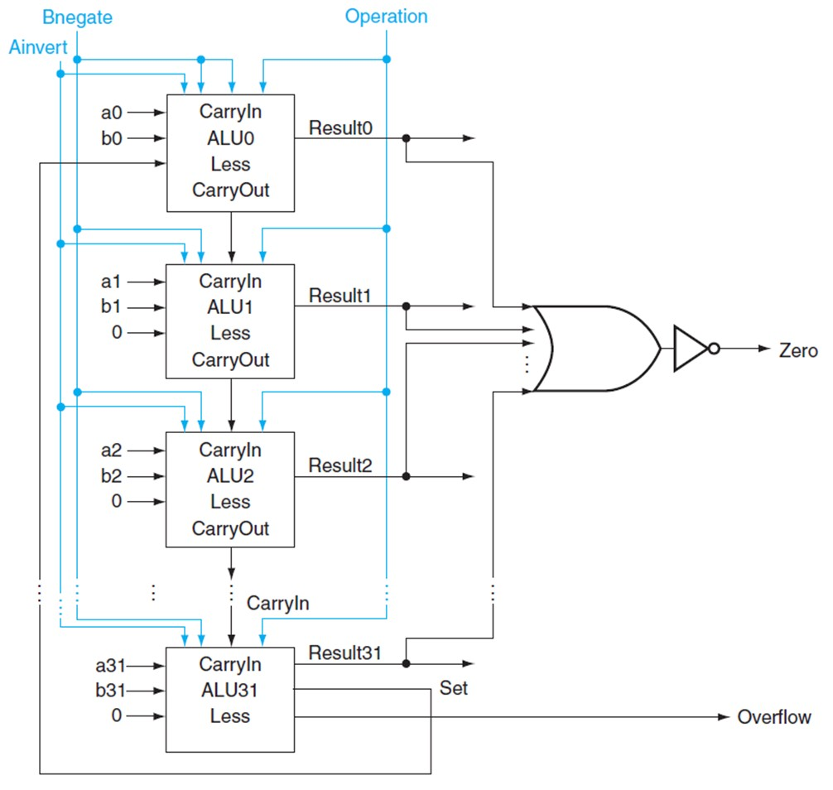
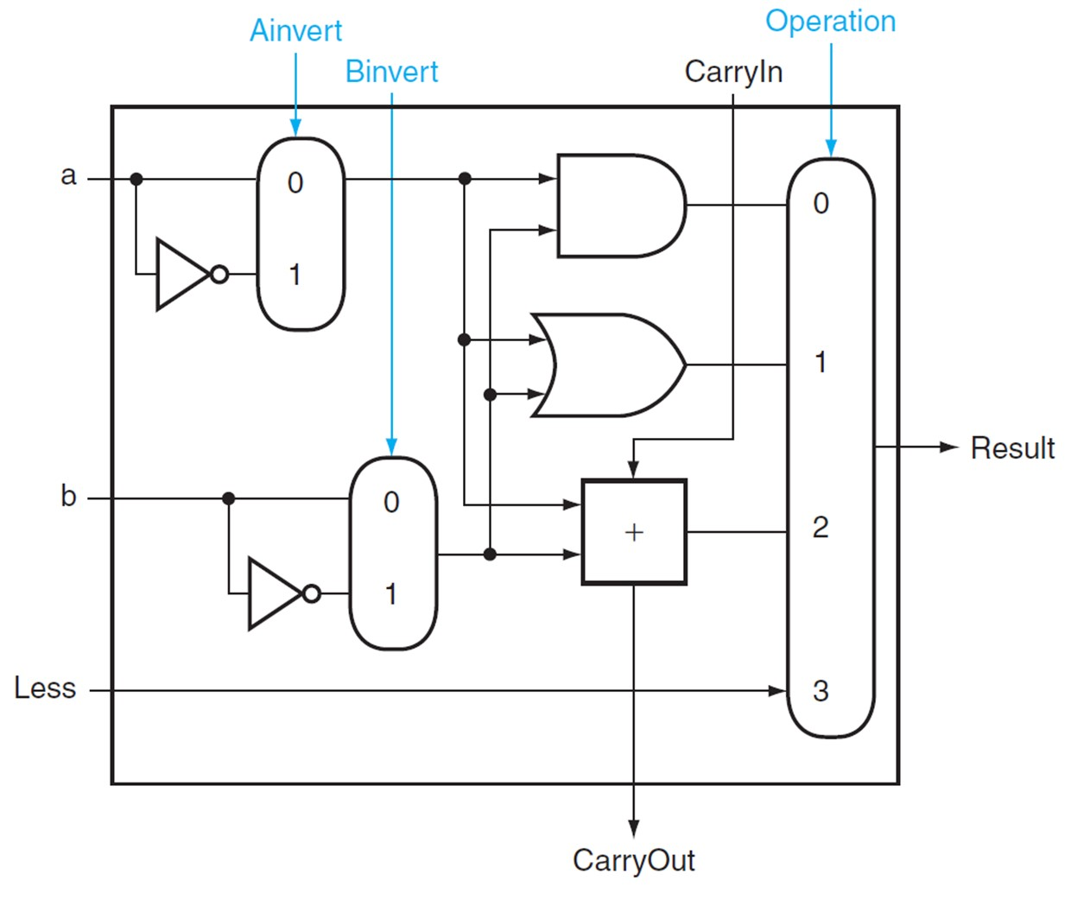
(Simplified) 32-bit ALU
1-bit ALU

Slide 23
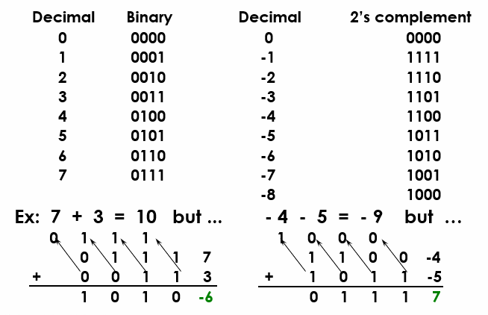
Overflow

Slide 24
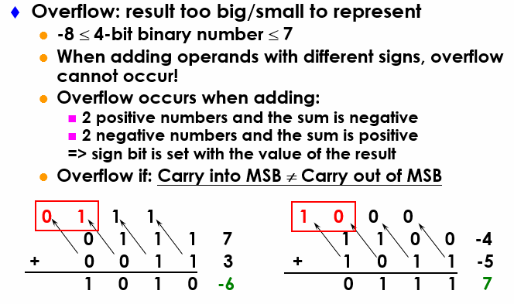
Overflow Detection
Notes:
Recalled from some earlier slides that the biggest positive number you can represent using 4-bit is 7 and the smallest negative you can represent is negative 8.
So any time your addition results in a number bigger than 7 or less than negative 8, you have an overflow.
Keep in mind is that whenever you try to add two numbers together that have different signs, that is adding a negative number to a positive number, overflow can NOT occur.
Overflow occurs when you to add two positive numbers together and the sum has a negative sign. Or, when you try to add negative numbers together and the sum has a positive sign.
If you spend some time, you can convince yourself that If the Carry into the most significant bit is NOT the same as the Carry coming out of the MSB, you have a overflow.
+2 = 41 min. (Y:21)

Slide 25
Overflow Detection Logic
Overflow = CarryIn[N-1] XOR CarryOut[N-1]
CarryIn0
A0
1-bit
ALU
Result0
X
Y
X XOR Y
B0
CarryOut0
0
0
0
CarryIn1
A1
0
1
1
1-bit
ALU
Result1
1
0
1
B1
CarryOut1
1
1
0
CarryIn2
A2
1-bit
ALU
Result2
B2
CarryIn3
Overflow
A3
1-bit
ALU
Result3
B3
CarryOut3
Notes:
Recall the XOR gate implements the not equal function: that is, its output is 1 only if the inputs have different values.
Therefore all we need to do is connect the carry into the most significant bit and the carry out of the most significant bit to the XOR gate.
Then the output of the XOR gate will give us the Overflow signal.
+1 = 42 min. (Y:22)

Slide 26
Dealing with Overflow
Some languages (e.g., C) ignore overflow
Use MIPS addu, addui, subu instructions
Other languages (e.g., Ada, Fortran) require raising an exception
Use MIPS add, addi, sub instructions
On overflow, invoke exception handler
Save PC in exception program counter (EPC) register
Jump to predefined handler address
mfc0 (move from coprocessor reg) instruction can retrieve (copy) EPC value (to a general purpose register), to return after corrective action (by jump register instruction)

Slide 27
Zero Detection Logic
Zero Detection Logic is a one BIG NOR gate (support conditional jump)
CarryIn0
A0
1-bit
ALU
Result0
B0
CarryIn1
CarryOut0
A1
1-bit
ALU
Result1
B1
Zero
CarryIn2
CarryOut1
A2
1-bit
ALU
Result2
B2
CarryIn3
CarryOut2
A3
1-bit
ALU
Result3
B3
CarryOut3
Notes:
Besides detecting overflow, our ALU also needs to indicate if the result is zero.
This is easy to do. All we need is a BIG NOR gate.
Then if any of the Result bit is not zero, then the output of the NOR gate will be low.
The only time the output of the NOR gate is high is when all the result bits are zeroes.
+1 = 43 min. (Y:23)

Slide 28
Ripple Carry Adder
Carry bit may have to propagate from LSB to MSB => worst case delay: N-stage delay
CarryIn0
A0
CarryIn
1-bit
ALU
Result0
B0
A
CarryIn1
CarryOut0
A1
1-bit
ALU
Result1
B1
CarryIn2
CarryOut1
A2
1-bit
ALU
Result2
B
B2
CarryIn3
CarryOut2
CarryOut
A3
Design Trick: look for parallelism and throw hardware at it
1-bit
ALU
Result3
B3
CarryOut3
Notes:
The Adder we just built is called a Ripple Carry Adder because: Carry may have to propagate from the least significant bit to the most significant bit.
In other words, the combination of A0, B0, and CarryIn0 may cause CarryOut0 to become 1.
As a result of CarryOut0 going 1, CarryOut1 may become 1 and etc., etc., .... etc and propagate down the carry chain.
Recall the Carry Logic: CarryIn to CarryOut has a 2-gate delay.
So in the worst case, a N-bit ripple carry will have a 2N gate delay.
For a 32-bit adder, this means the worst case delay is 64 gates. This can be a problem.
So after the break, I will show you some faster way of designing an ALU.
+2 = 45 min. (Y:25)

Slide 29
Carry-Lookahead Adder
Carry-lookahead adder
a₀
b₀
s₀
s₀ = a₀ ⊕ b₀ ⊕ c₀
c₀
c₁ = a₀b₀ + a₀c₀ + b₀c₀
c₁
c₁ = a₀b₀ + (a₀ + b₀)c₀
= g₀ + p₀c₀
c₂ = a₁b₁ + (a₁ + b₁)c₁
= g₁ + p₁c₁
= g₁ + p₁g₀ + p₁p₀c₀
c₃= a₂b₂ + (a₂ + b₂)c₂
= g₂ + p₂c₂
= g₂ + p₂g₁ + p₂p₁g₀+p₂p₁p₀c₀

Slide 30
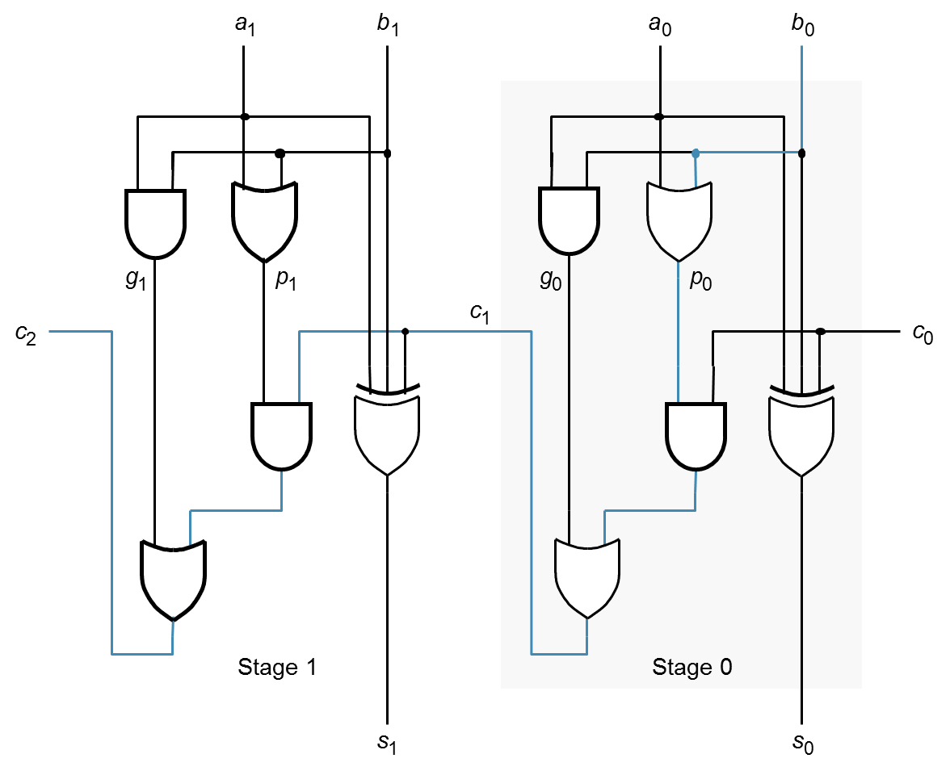
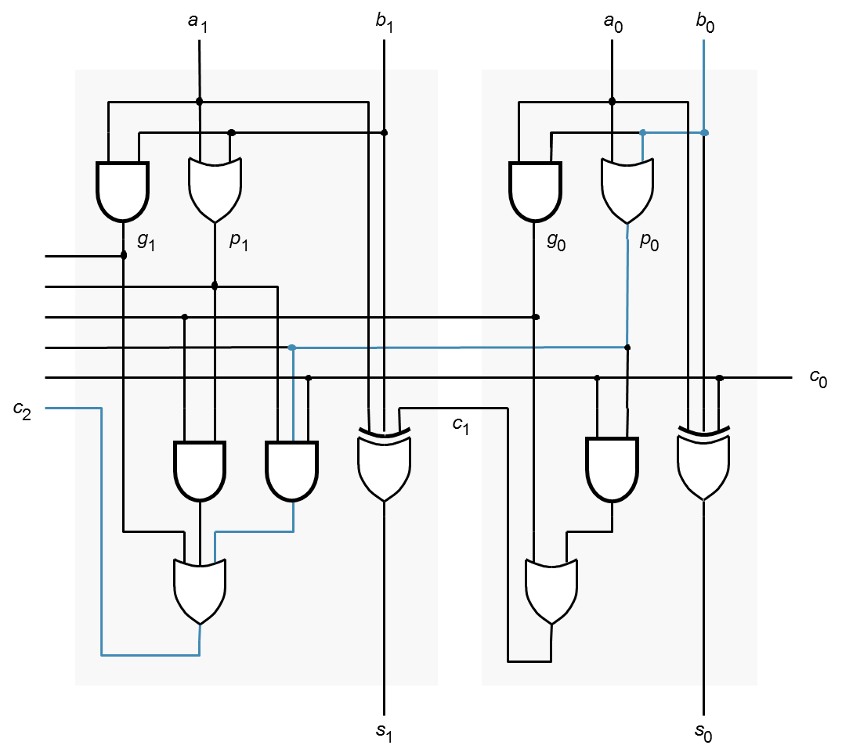
Critical Path Delay
Ripple-Carry Adder
Delay = 2n + 1
Carry-Lookahead Adder
Delay = 4

Slide 31
Multiplication
More complicated than addition
Can be accomplished via shifting and adding
Double precision product is produced
More time and more area is required
0010
× 1011
0010
00100
000000
0010000
00010110
(multiplicand)
(multiplier)
(partial product array)
(product)

Slide 32
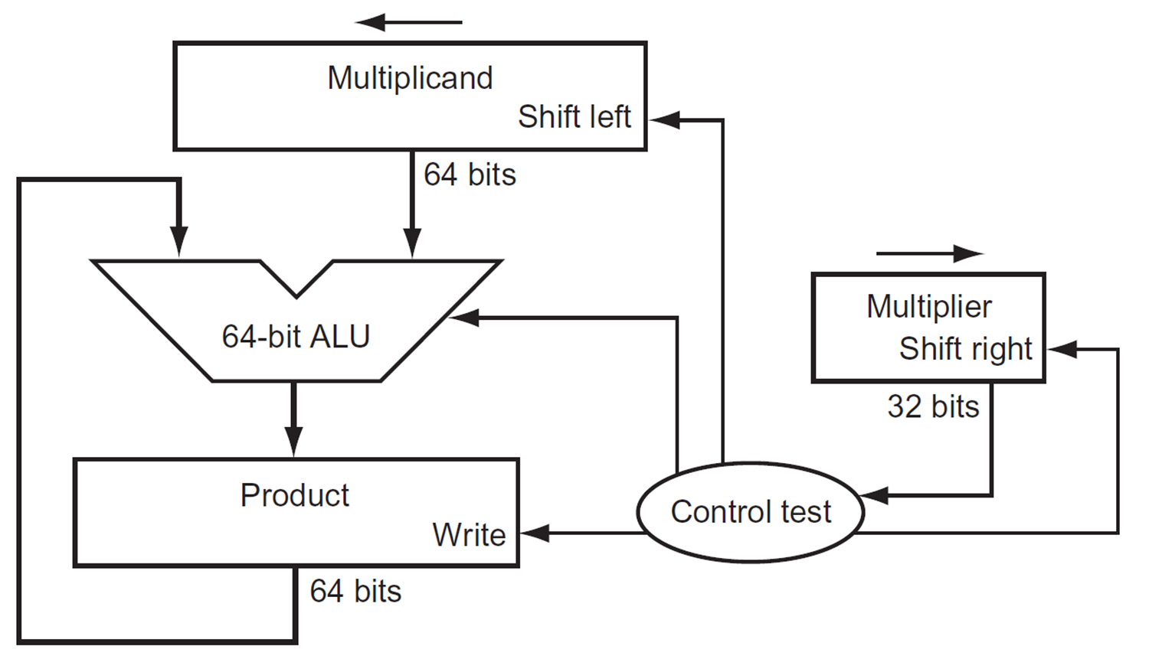
Multiplication Hardware (1st Version)

Slide 33
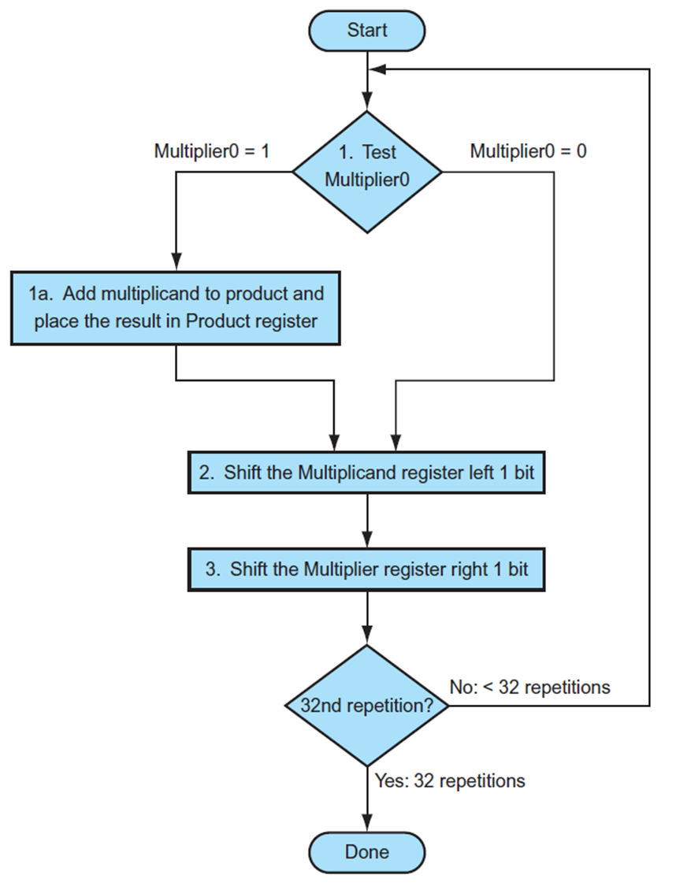
Multiplication Algorithm

Slide 34
Multiplication Hardware (2nd Version)
32-bit Multiplicand register, 32 -bit ALU, 64-bit Product register (HI & LO in MIPS), (0-bit Multiplier register)

Slide 35
Multiplication Hardware (2nd Version)
Start
0010 x 0011
Multiplicand Product 0010 0000 0011
0010 0011
0010 0001 0001
0011 0001
0010 0001 1000
0010 0000 1100
0010 0000 0110
Product0 = 1
1. Test
Product0
Product0 = 0
1a. Add multiplicand to left half of product and
place the result in left half of Product register
2. Shift Product register right 1 bit
32nd
repetition?
No: < 32 repetitions
Yes: 32 repetitions
Done

Slide 36
MIPS Multiplication Instruction
Two 32-bit registers for product
HI: most-significant 32 bits
LO: least-significant 32-bits
Instructions
mult rs, rt / multu rs, rt
64-bit product in HI/LO
mfhi rd / mflo rd
Move from HI/LO to rd
Can test HI value to see if product overflows 32 bits
mul rd, rs, rt
Least-significant 32 bits of product ➔ rd

Slide 37
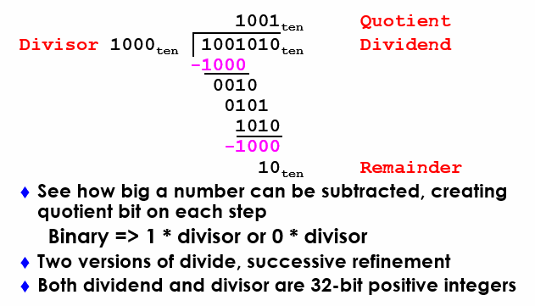
Divide: Paper & Pencil

Slide 38
Divide Hardware - Version 1 (1)
64-bit Divisor register (initialized with 32-bit divisor in left half), 64-bit ALU, 64-bit Remainder register (initialized with 64-bit dividend), 32-bit Quotient register
Divisor
Shift Right
64 bits
Quotient
Shift Left
64-bit ALU
32 bits
Remainder
Write
Control
64 bits

Slide 39
Divide Hardware - Version 1 (2)
0111 / 0010
Quot. Divisor Rem.
0000 00100000 00000111 11100111 00000111 0000 00010000 00000111 11110111 00000111 0000 00001000 00000111 11111111 00000111 0000 00000100 00000111 00000011 0001 00000011 0001 00000010 00000011 00000001 0011 00000001 0011 00000001 00000001
Start: Place Dividend in Remainder
1. Subtract Divisor register from
Remainder register, and place the
result in Remainder register
Remainder ≥ 0
Test Remainder
Remainder < 0
2a. Shift Quotient register to left, setting new rightmost bit to 1
2b. Restore original value by adding Divisor to Remainder, place sum in Remainder, shift Quotient to the left, setting new least significant bit to 0
3. Shift Divisor register right 1 bit
33rd
repetition?
No: < 33 repetitions
Yes: 33 repetitions
Done
Notes:
Q: 0000 D: 0010 0000 R: 0000 0111  = 1110 0000
1: R = R Q: 0000 D: 0010 0000 R: 1110 0111
2b: +D, sl Q, 0 Q: 0000 D: 0010 0000 R: 0000 0111
3: Shr D Q: 0000 D: 0001 0000 R: 0000 0111  = 1111 0000
1: R = R Q: 0000 D: 0001 0000 R: 1111 0111
2b: +D, sl Q, 0 Q: 0000 D: 0001 0000 R: 0000 0111
3: Shr D Q: 0000 D: 0000 1000 R: 0000 0111  = 1111 1000
1: R = R Q: 0000 D: 0000 1000 R: 1111 1111
2b: +D, sl Q, 0 Q: 0000 D: 0000 1000 R: 0000 0111
3: Shr D Q: 0000 D: 0000 0100 R: 0000 0111  = 1111 1100
1: R = R Q: 0000 D: 0000 0100 R: 0000 0011
2a: sl Q, 1 Q: 0001 D: 0000 0100 R: 0000 0011
3: Shr D Q: 0000 D: 0000 0010 R: 0000 0011  = 1111 1110
1: R = R Q: 0000 D: 0000 0010 R: 0000 0001
2a: sl Q, 1 Q: 0011 D: 0000 0010 R: 0000 0001
3: Shr D Q: 0011 D: 0000 0001 R: 0000 0001
Recommend show 2 comp of divisor, show lines for subtract divisor and restore remainder

Slide 40
Observations - Version 1
Half of the bits in divisor register always 0 => 1/2 of 64-bit adder is wasted => 1/2 of divisor is wasted
Instead of shifting divisor to right, shift remainder to left?
1st step cannot produce a 1 in quotient bit => switch order to shift first and then subtract => save 1 iteration
Eliminate Quotient register by combining with Remainder register as shifted left

Slide 41
Divide Hardware - Version 2 (1)
32-bit Divisor register, 32 -bit ALU, 64-bit Remainder register, (0-bit Quotient register)
Divisor
32 bits
32-bit ALU
Shift Left
Remainder
(Quotient)
Control
64 bits
Write

Slide 42
Divide Hardware - Version 2 (2)
Start: Place Dividend in Remainder
0111 / 0010
Step Remainder Div. 0 0000 0111 0010
1.1 0000 1110
1.2 1110 1110
1.3b 0001 1100
2.2 1111 1100
2.3b 0011 1000 3.2 0001 1000
3.3a 0011 0001
4.2 0001 0001
4.3a 0010 0011
0001 0011
1. Shift Remainder register left 1 bit
2. Subtract Divisor register from the left half of Remainder register, and place the
result in the left half of Remainder register
Remainder ≥ 0
Test Remainder
Remainder < 0
3b. Restore original value by adding Divisor to left half of Remainder, and place sum in left half of Remainder. Also shift Remainder to left, setting the new least significant bit to 0
3a. Shift Remainder to left, setting new rightmost bit to 1
32nd
repetition?
No: < 32 repetitions
Yes: 32 repetitions
Done. Shift left half of Remainder right 1 bit
Notes:
D: 0010 R: 0000 0111
0: Shl R D: 0010 R: 0000 1110
1: R = R D: 0010 R: 1110 1110
2b: +D, sl R, 0 D: 0010 R: 0001 1100
1: R = R D: 0010 R: 1111 1100
2b: +D, sl R, 0 D: 0010 R: 0011 1000
1: R = R D: 0010 R: 0001 1000
2a: sl R, 1 D: 0010 R: 0011 0001
1: R = R D: 0010 R: 0001 0001
2a: sl R, 1 D: 0010 R: 0010 0011
Shr R(rh) D: 0010 R: 0001 0011

Slide 43
MIPS Division Instruction
Instruction
div $t1, $t2 # t1 / t2
Quotient stored in Lo, remainder in Hi
mflo $t3 #copy quotient to t3
mfhi $t4 #copy remainder to t4
3-step process
Unsigned division:
divu $t1, $t2 # t1 / t2
Just like div, except now interpret t1, t2 as unsigned integers instead of signed
Answers are also unsigned, use mfhi, mflo to access
No overflow or divide-by-0 checking
Software must perform checks if required

Slide 44
Signed Divide
Remember signs, make positive, complement quotient and remainder if necessary
Let Dividend and Remainder have same sign and negate Quotient if Divisor sign & Dividend sign disagree,
e.g., -7÷ 2 = -3, remainder = -1
-7÷ - 2 = 3, remainder = -1
Satisfy Dividend =Quotient x Divisor + Remainder

Slide 45
Observations: Multiply and Divide
Same hardware as multiply: Just need ALU to add or subtract, and 64-bit register to shift left (multiply: shift right)
Hi and Lo registers in MIPS combine to act as 64-bit register for multiply and divide
Divisor
32 bits
32-bit ALU
Shift Left
Remainder
(Quotient)
Control
64 bits
Write

Slide 46
Multiply/Divide Hardware
32-bit Multiplicand/Divisor register, 32 -bit ALU, 64-bit Product/Remainder register, (0-bit Multiplier/Quotient register)
Multiplicand/
Divisor
32 bits
32-bit ALU
Shift Right
Product/
Remainder
Multiplier/
Quotient
Shift Left
Control
Write
64 bits

Slide 47
Floating-Point Numbers
Representation for non-integral numbers
Include very small and very large numbers
Like scientific notation
–2.34 × 10⁵⁶
+0.002 × 10^{–4}
+987.02 × 10⁹
In binary
±1.xxxxxxx₂ × 2^{yyyy}
Types float and double in C
(normalized)
(not normalized)

Slide 48
Floating-Point Standard
Defined by IEEE 754-1985 standard
Developed in response to divergence of representations
Portability issues for scientific code
Now almost universally adopted
Two representations
Single precision (32-bit)
Double precision (64-bit)

Slide 49
IEEE Floating-Point Format
1 bit
8 bits
23 bits
s
exponent
fraction/mantissa
Single-Precision
x = (−1)^{s} × (1+fraction) × 2^{(exponent−127)}
exponent | fraction | Value represented
0000 0000 | 0 | 0
1111 1111 | 0 | ±∞
1111 1111 | non-zero | NaN
1 bit
11 bits
52 bits
s
exponent
fraction/mantissa
Double-Precision
x = (−1)^{s} × (1+fraction) × 2^{(exponent−1023)}

Slide 50
Exercise L04-2
Ex-1: What is the IEEE single precision number 0x40C00000 representing in decimal?
0x40C00000 = 0100 0000 1100 0000 0000 0000 0000 0000
x = (−1)^{s} × (1+fraction) × 2^{(exponent−127)}
0x40C00000 = 0 100 0000 1 100 0000 0000 0000 0000 0000
= (−1)⁰ × (1+0.100…000) × 2⁽¹²⁹⁻¹²⁷⁾
= 1.100…000 × 2²
= 1102
Notes:
Binary: [0][100 0000 1][100 0000 0000 0000 0000 0000]
Sign: +
Exponent: 129 – 127 = +2
Mantissa: 0b1.1
x = +0b1.1 x 2^(2) = +0b110 = +6

Slide 51
Exercise L04-3
Ex-2: How to represent –0.5 in IEEE single precision binary floating-point format?
–0.5 = (−1)¹ × 0.5 (decimal)
= (−1)¹ × 1/2 (decimal)
= (−1)¹ × 1.0 × 2⁻¹ (binary)
x = (−1)^{s} × (1+fraction) × 2^{(exponent−127)}
1 011 1111 0 000 0000 0000 0000 0000 0000
Notes:
0.5 = 0b0.1 = 0b1 x 2^(-1)
Exponent: (-1)+127 = 126 = 0b01111110
Sign = 1
Mantissa: 0000 … 0000
Answer:
1 01111110 000 0000 0000 0000 0000 0000

Slide 52
Exercise L04-4
Ex-3: How to represent –0.75 in IEEE single precision binary floating-point format?
–0.75 = (−1)¹ × 0.75 (decimal)
= (−1)¹ × 3/4 (decimal)
= (−1)¹ × 1.1 × 2⁻¹ (binary)
x = (−1)^{s} × (1+fraction) × 2^{(exponent−127)}
1 011 1111 0 100 0000 0000 0000 0000 0000
Notes:
0.5 = 0b0.1 = 0b1 x 2^(-1)
Exponent: (-1)+127 = 126 = 0b01111110
Sign = 1
Mantissa: 0000 … 0000
Answer:
1 01111110 000 0000 0000 0000 0000 0000

Slide 53
Floating-Point Addition (1)
Consider a 4-digit decimal example
9.999 × 10¹ + 1.610 × 10^{–1}
1. Align decimal points
Shift number with smaller exponent
9.999 × 10¹ + 0.016 × 10¹
2. Add significands
9.999 × 10¹ + 0.016 × 10¹ = 10.015 × 10¹
3. Normalize result & check for over/underflow
1.0015 × 10²
4. Round and renormalize if necessary
1.002 × 10²

Slide 54
Floating-Point Addition (2)
Now consider a 4-digit binary example
1.000₂ × 2^{–1} + –1.110₂ × 2^{–2} (0.5 + –0.4375)
1. Align binary points
Shift number with smaller exponent
1.000₂ × 2^{–1} + –0.111₂ × 2^{–1}
2. Add significands
1.000₂ × 2^{–1} + –0.111₂ × 2^{–1} = 0.001₂ × 2^{–1}
3. Normalize result & check for over/underflow
1.000₂ × 2^{–4}, with no over/underflow
4. Round and renormalize if necessary
1.000₂ × 2^{–4} (no change) = 0.0625

Slide 55
FP Adder Hardware (1)
Much more complex than integer adder
Doing it in one clock cycle would take too long
Much longer than integer operations
Slower clock would penalize all instructions
FP adder usually takes several cycles
Can be pipelined

Slide 56
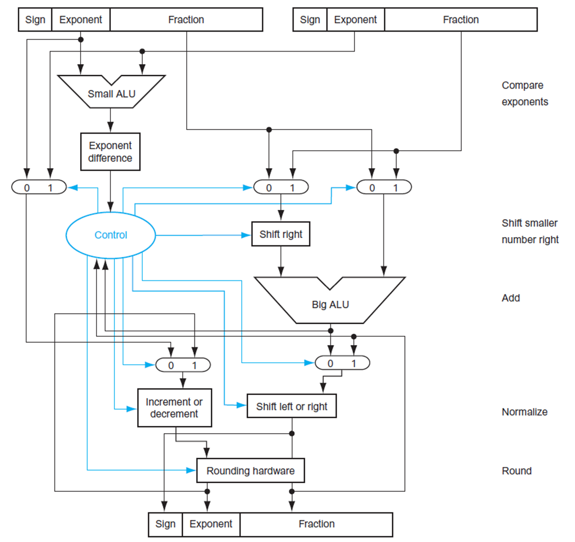
FP Adder Hardware (2)
Step 1
Step 2
Step 3
Step 4

Slide 57
FP Arithmetic Hardware
FP multiplier is of similar complexity to FP adder
But uses a multiplier for significands instead of an adder
FP arithmetic hardware usually does
Addition, subtraction, multiplication, division, reciprocal, square-root
FP ↔ integer conversion
Operations usually takes several cycles
Can be pipelined

Slide 58
FP Instructions in MIPS (1)
FP hardware is coprocessor 1
Adjunct processor that extends the ISA
Separate FP registers
32 single-precision: $f0, $f1, … $f31
Paired for double-precision: $f0/$f1, $f2/$f3, …
FP instructions operate only on FP registers
Programs generally don’t do integer ops on FP data, or vice versa
More registers with minimal code-size impact
FP load and store instructions
lwc1, ldc1, swc1, sdc1
e.g., ldc1 $f8, 32($sp)

Slide 59
FP Instructions in MIPS (2)
Single-precision arithmetic
add.s, sub.s, mul.s, div.s
e.g., add.s $f0, $f1, $f6
Double-precision arithmetic
add.d, sub.d, mul.d, div.d
e.g., mul.d $f4, $f4, $f6
Single- and double-precision comparison
c.xx.s, c.xx.d (xx is eq, lt, le, gt, ge)
Sets or clears FP condition-code bit
e.g. c.lt.s $f3, $f4
Branch on FP condition code true or false
bc1t, bc1f
e.g., bc1t TargetLabel

